Slide 1
Uno!
Team Hello World
Notes:
We made our own version of the card game Uno!

Slide 2
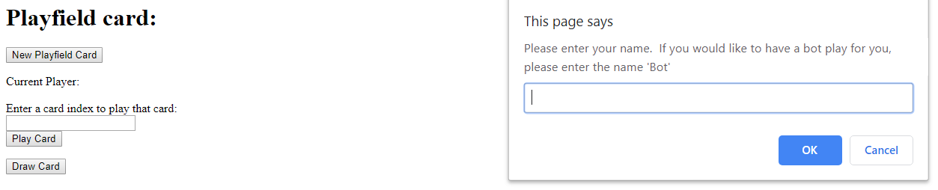
Before/After of UI + key features
Notes:
In project 3 we built the basic functionality for the game. In project 4 our goal was to make it look better, so we’re going to show the before/after screenshots of that.
This is the original start screen. You can see it doesn’t look very pretty. *click to next slide*

Slide 3
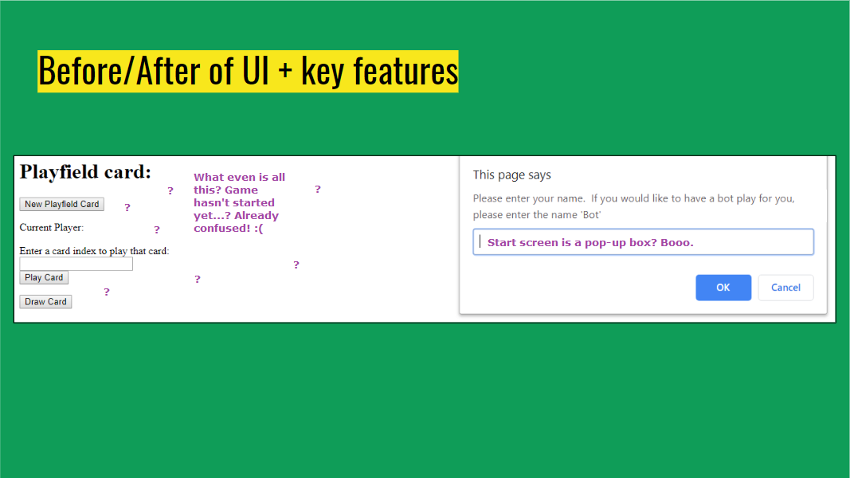
Notes:
Point out annoying parts of this start screen

Slide 4
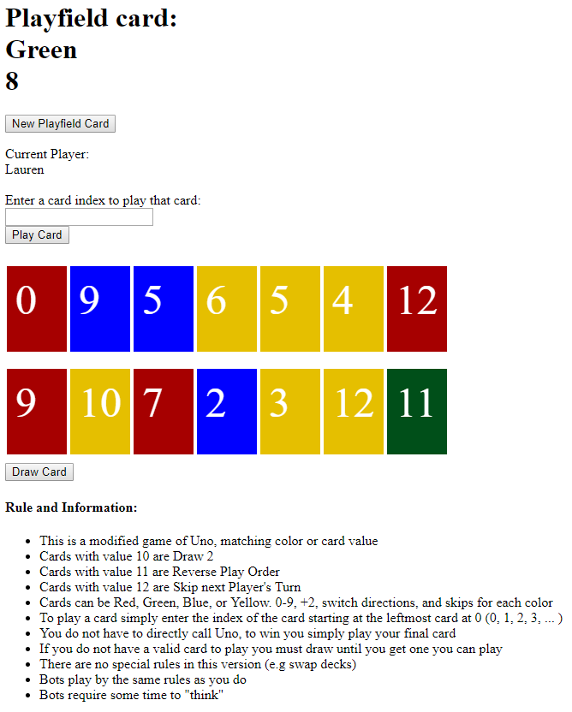
Before/After of UI + key features
Notes:
This is the original game once you get past the start screen. Remember, this is supposed to be the Uno game. The game is basically here, but you wouldn’t know it by the way it looks. *click to next screen*

Slide 5
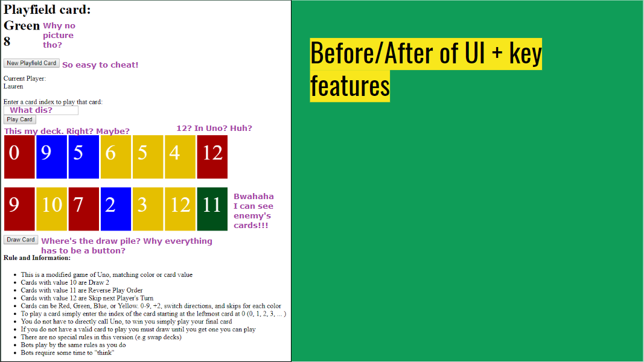
Notes:
Point out annoying parts of this game screen

Slide 6
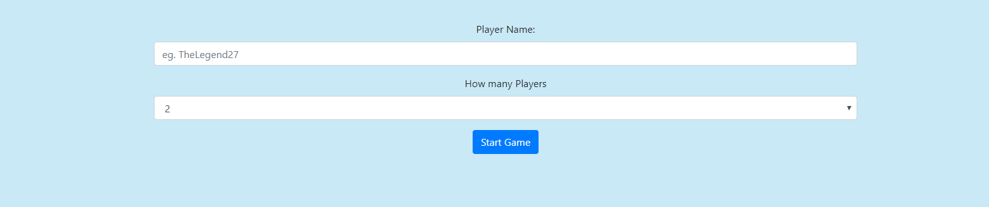
Before/After of UI + key features
Notes:
This is the start screen after we finished project 4. Much more intuitive!

Slide 7
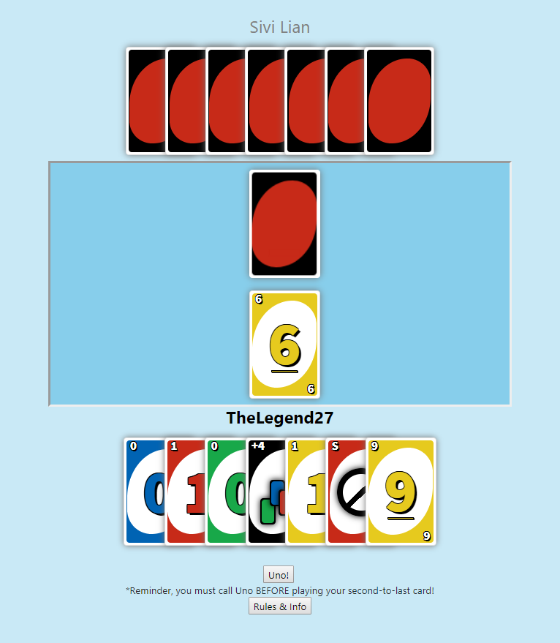
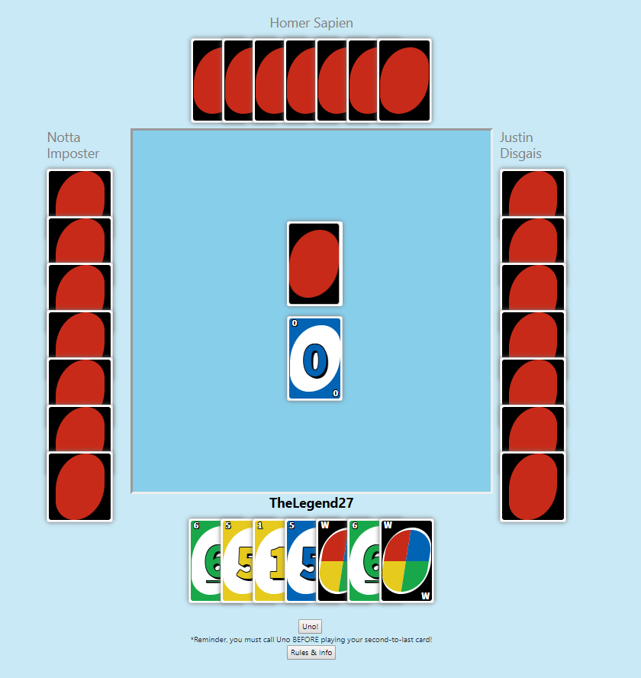
Before/After of UI + key features
Notes:
This is the game screen. The left side shows 2 players and the right side is a 4 player game. Now you can tell it’s an Uno game.

Slide 8
Before/After of UI + key features
Notes:
Here’s another juxtaposition. Definitely a big change.

Slide 9
Before/After of UI + key features
Notes:
The game screen is way better now, it’s especially obvious when you compare them side by side like this. Same game for the most part, but two different UIs.
Our original goal was to finish project 3 with a nice UI and have all the game logic working correctly. Then for project 4 we would add multiplayer. Since we didn’t get the UI finished in project 3, we decided to focus on that for project 4 instead of multiplayer. We decided to do this because we thought having a good-looking game made more sense than to add extra complexity to a game that was already confusing to look at.

Slide 10
Game demo
Notes:
***Rest of PowerPoint is talking, not showing slides***
1 player vs. bot
Show off uno logic
Show off error sound
Show off card shaking,
Show off cheat codes,
Show off win state
Begin 4 player Bot game, then continue reading from slides

Slide 11
Notes:
Built using JavaScript, CSS, HTML, JQuery
Talk about CSS for cards, difficulties faced
Talk about animations for cards, difficulties faced
Talk about game logic, difficulties faced
Talk about any other difficulties faced

Slide 12
Notes:
Bugs
Playfield size doesn’t stay the same
Skip and Reverse symbols are colored black to cover up a bug where the color changes as new Skip and Reverse cards are drawn
Features unable to do
Not recording voice for Uno! (multiple variations didn’t make the cut)

Slide 13
Notes:
Testing Suite - Eric

